Slide 1
Bone Histomorphometry
Jaya Krishna Nidasanametla
jxn306@case.edu
Project - EBME 695 (1 Credits)

Slide 2
Training
Built a U-net model for semantic segmentation of the images to generate the map.
A total of 142 images generated from the 9 patient maps.
Selected 4 majority classes including Bone, Void, Osteoid and Osteoclast Srf to train on initially.
Annotated the images using labelme tool using the maps as the ground truth to the best of possibility.
Built on 60 imges and tested on 20 images.
Acheived a training accuracy of 97%.

Slide 3
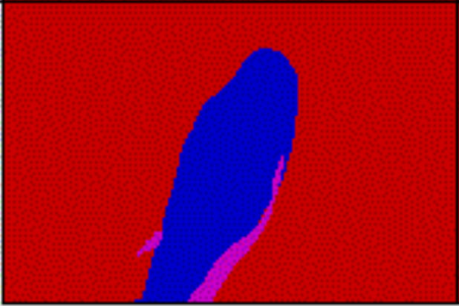
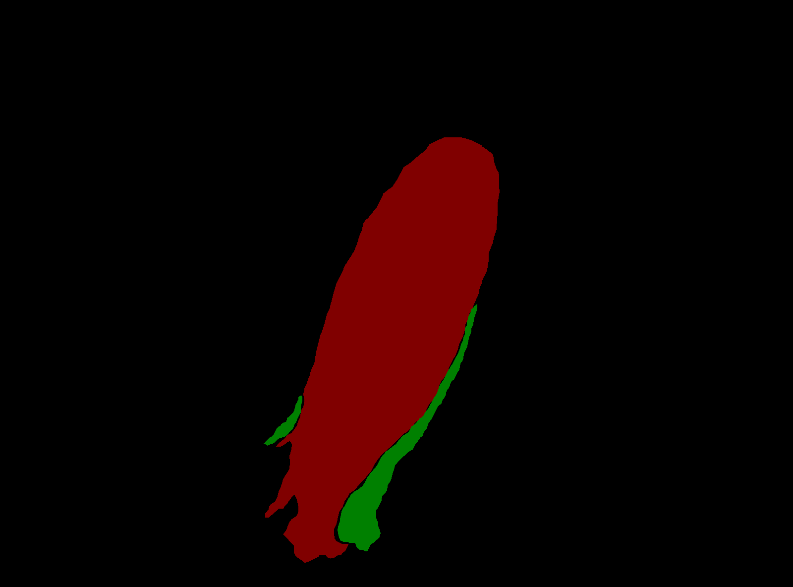
Annotations using maps as ground truth
Ground Truth
Annotated image using the map

Slide 4
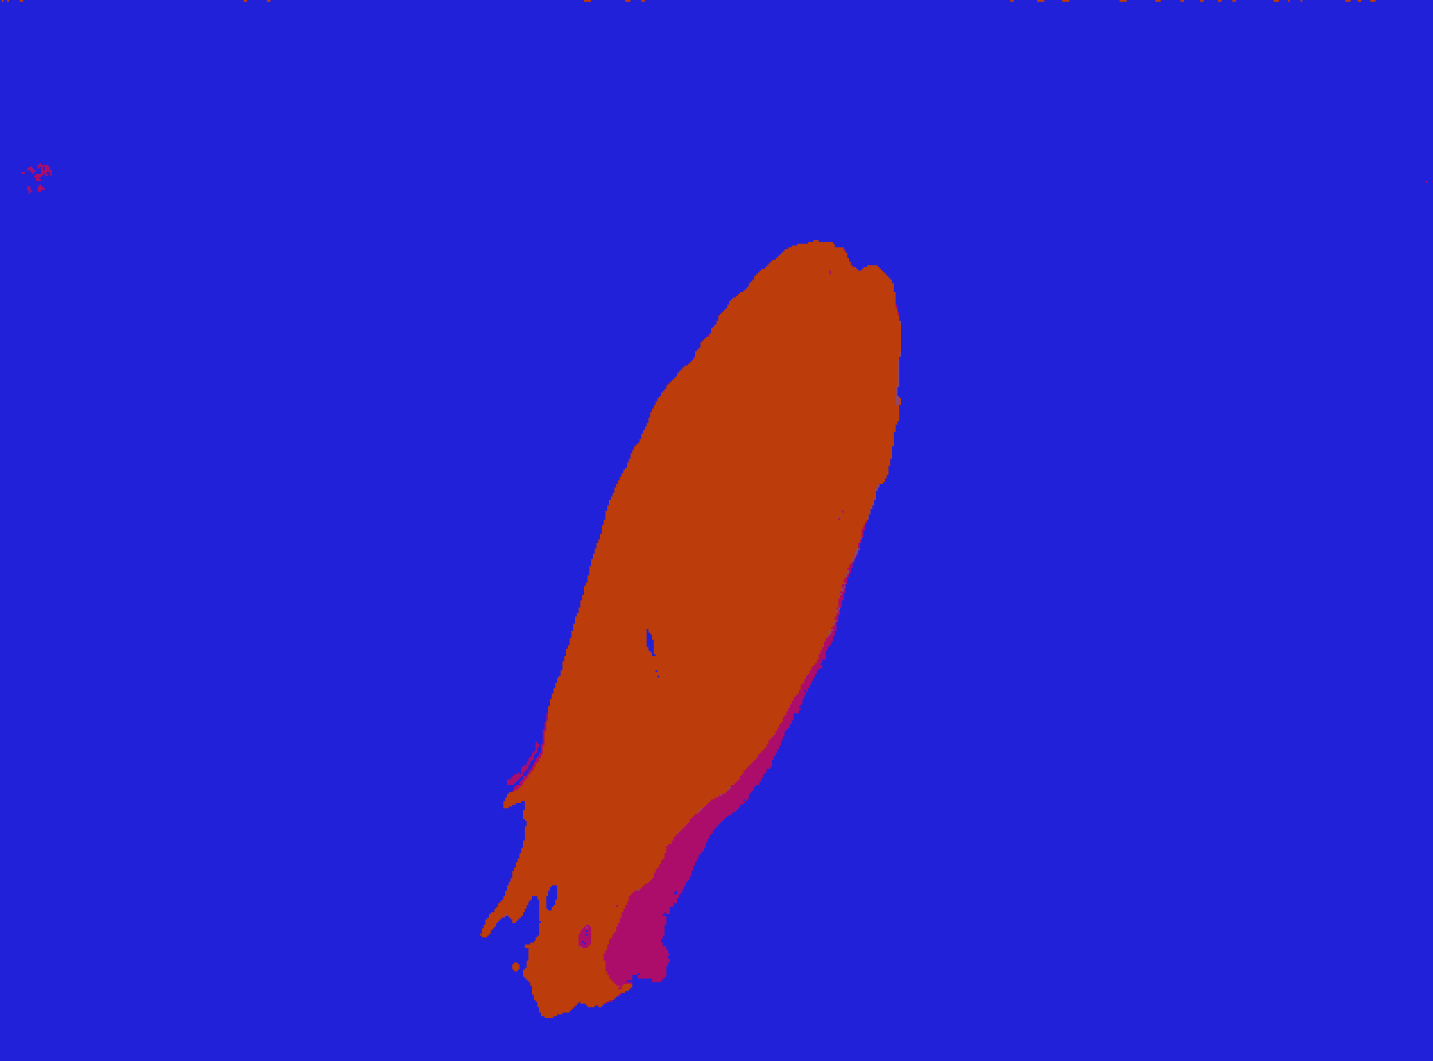
Few Results - Ground truth against Predicted
Ground truth / Map
Predicted output from the model

Slide 5
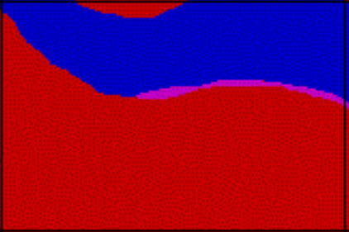

Few Results - Ground truth against Predicted
Ground truth / Map
Predicted output from the model

Slide 6
Thank You...

